Slide 1
I210 – Introduction to Programming with Python
Lecture 15

Slide 2

Today
Dictionaries!
Dictionary methods

Slide 3
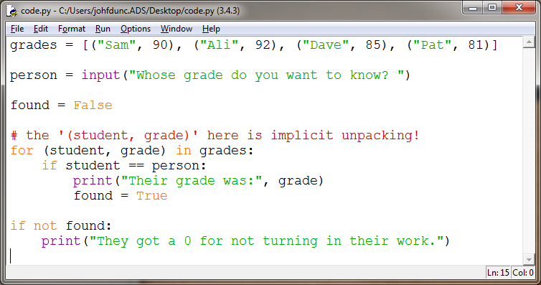
grades.py
Consider this program for grades:

Slide 4
grades.py
Consider this program for grades:
grades = [("Sam", 90), ("Ali", 92), ("Dave", 85), ("Pat", 81)]
person = input("Whose grade do you want to know? ")
found = False
for (student, grade) in grades:
if student == person:
print("Their grade was:", grade)
found = True
if not found:
print("They got a 0 for not turning in their work.")
A Boolean variable like found, whose value changes in order to allow us to make a decision later, is called a flag.

Slide 5
grades.py
Consider this program for grades:
grades = [("Sam", 90), ("Ali", 92), ("Dave", 85), ("Pat", 81)]
person = input("Whose grade do you want to know? ")
found = False
for (student, grade) in grades:
if student == person:
print("Their grade was:", grade)
found = True
if not found:
print("They got a 0 for not turning in their work.")
Notice that we have to manually search the list, because the student’s name tells us nothing about where they occur in the list!!

Slide 6
grades.py
Wouldn’t it be nice if we could just say:
grades = [("Sam", 90), ("Ali", 92), ("Dave", 85), ("Pat", 81)]
person = input("Whose grade do you want to know? ")
print( grades[person] ) #try to use the name as an index?
>>>
TypeError: list indices must be integers, not str
We want to be able to use strings as indices. ..
And we can, with a different data structure - dictionaries!

Slide 7
Dictionaries
Like a real one, a dictionary in Python has this format: word : definition
When you look up the word (a key) you get its definition (a value).
This allows us to index into something using a string instead of integers!!

Slide 8
Dictionaries
Dictionaries use this format:
# notice the { } here!
indiana_terms = {"IU": "Indiana's flagship university",
"Purdue": "Clearly not as good, right?",
"cardinal": "Official state bird of Indiana",
"hoosier": "Name for someone living in Indiana"}
print(indiana_terms["cardinal"])
>>>
Official state bird of Indiana

Slide 9
Dictionaries
So the key works like an index…
What if you try to access a key that doesn’t exist?
print(indiana_terms["nope"])
>>>
Traceback (most recent call last):
File "C:/Users/J/Desktop/code.py", line 22, in <module>
print(indiana_terms["nope"])
KeyError: 'nope'
You can also use the in operator with dictionaries.
if key_var in indiana_terms :
print(indiana_terms[key_var])

Slide 10
grades.py
Now we can say:
grades = {"Sam": 90, "Ali": 92, "Dave": 85, "Pat": 81}
person = input("Whose grade do you want to know? ")
print(person, "got a", grades[person] ) #use the name as an index!
But we will still get a Key Error if they input an invalid key (a name that doesn’t exist).
We also aren’t handling the case where there’s no record.

Slide 11
grades.py
We can fix those problems by using in:
grades = {"Sam": 90, "Ali": 92, "Dave": 85, "Pat": 81}
person = input("Whose grade do you want to know? ")
if person in grades:
print(person, "got a", grades[person])
else:
print("They got a 0 for not turning in their work.")

Slide 12
Dictionaries
Adding an entry:
grades["Jim"] = 97
Changing the value of an entry:
grades["Pat"] = 88
Deleting an entry:
del grades["Sam"]

Slide 13
Dictionaries
Dictionaries can’t contain multiple entries with the same key! (keys are unique)
Keys have to be immutable. (Strings, numbers, tuples)
Values don’t have to be unique.

Slide 14
Dictionaries
The .get() method allows us to return the value at an index, or an alternate message if that index doesn’t exist.
Anyone without a grade got a 0, right?
person = "Sam"
print(person, "got a", grades.get(person, "0"))
>>>
"Sam got a 90"
person = "Alan"
print(person, "got a", grades.get(person, "0"))
>>>
"Alan got a 0"
We can assign the result of .get() to a variable or use it directly!

Slide 15
grades.py
grades = {"Sam": 90, "Ali": 92, "Dave": 85, "Pat": 81}
person = input("Whose grade do you want to know? ")
print(person, "got a", grades.get(person, "0"))
Those 3 lines above do roughly the same thing as that 9 line program from before!
grades = [("Sam", 90), ("Ali", 92), ("Dave", 85), ("Pat", 81)]
person = input("Whose grade do you want to know? ")
found = False
for (student, grade) in grades:
if student == person:
print("Their grade was:", grade)
found = True
if not found:
print("They got a 0 for not turning in their work.")

Slide 16
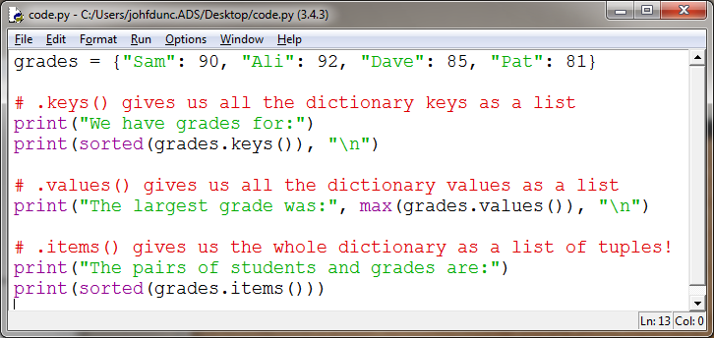
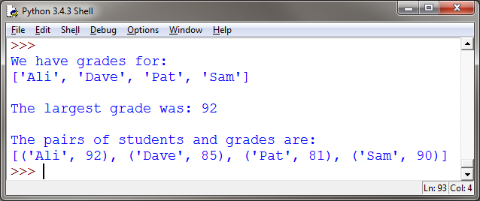
Selected Dictionary Methods

Slide 17
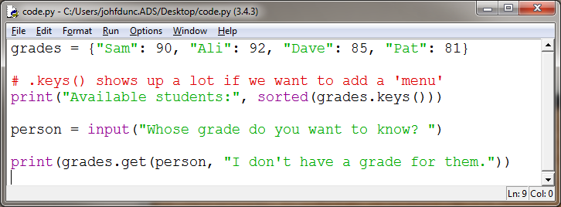
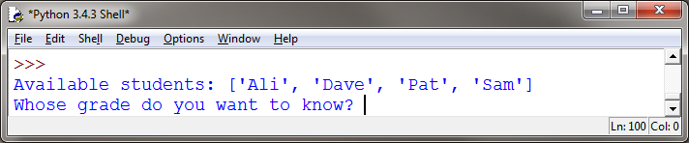
.keys()

Slide 18
Questions?

